Slide 1
IBM University Engagement Project Submission
FITNESS BUDDY
An AI-Powered Fitness Coach
Powered by IBM Granite through IBM watsonx.ai
HEALTH & WELLNESS | EDUCATION TECHNOLOGY

Slide 2

Project Title & Student Details
Project Title — Fitness Buddy: AI-Powered Fitness Coach
Domain of Project — Health & Wellness / Education
Student Name
Recent Passport Photo
Email ID
Mobile Number / WhatsApp
ADITYA PAREEK
keshavpareek603@gmail.com
9950939098
PROJECT FOCUS
CORE TECHNOLOGY
Personalized home workouts, practical meal ideas, motivation and habit-building.
IBM Cloud Lite / watsonx.ai Runtime with IBM Granite; Python and Streamlit interface.

Slide 3
Problem Statement No. 13 — Fitness Buddy
THE CHALLENGE
PROJECT OBJECTIVE
Many people struggle to maintain a healthy lifestyle because guidance can be generic, expensive, hard to fit into busy schedules, or difficult to sustain without motivation.
Build an accessible, conversational fitness coach that adapts practical guidance to a user's goal, fitness level, available time, equipment and food preference.
TARGET USERS
USER PAIN POINTS
WHY CURRENT OPTIONS FALL SHORT
• Students and busy adults
• Beginners exercising at home
• People seeking simple everyday wellness guidance
• Limited time and equipment
• Confusing or generic advice
• Inconsistent motivation
• Difficulty building repeatable habits
Some solutions require subscriptions or appointments; others offer rigid routines that do not adapt to a user's schedule, preferences or equipment.
REQUIRED CAPABILITIES
Personalized workouts
Meal ideas
Motivation
Habit-building
Home routines based on user input.
Simple suggestions aligned with food preference.
Encouragement and practical restart tips.
Daily checklists and a weekly consistency view.
.

Slide 4
Proposed Solution — Fitness Buddy
SOLUTION OVERVIEW
Fitness Buddy is a browser-based conversational assistant built with Python and Streamlit. It uses IBM Granite through watsonx.ai to provide practical, profile-aware responses for common fitness and wellness tasks.
PERSONALIZATION LOOP
1 User profile
Goal • level • time • equipment
HOW IT DELIVERS VALUE
↓
• Uses the user's stated level, goal, time, equipment and food preference.
• Provides actionable responses in one simple interface.
• Stores habit checklist entries locally and summarizes recent consistency.
• Routes queries to the right fitness specialist.
2 Request routing
Select a task-specific coach module
↓
3 IBM Granite
Generate a tailored response via watsonx.ai
↓
4 Next steps
Workout • meal idea • habit action
Users remain in control of every action.

Slide 5
Technology Used
IBM Cloud Lite / Runtime
IBM Granite 4 H Small
Provides the IBM cloud environment and managed watsonx.ai Runtime for model inference, subject to plan and quota.
Primary conversational foundation model: ibm/granite-4-h-small.
IBM watsonx.ai
Python
Hosts the inference endpoint used by the application to request Granite responses.
Implements application logic, profile context, intent routing, validation and helper modules.
Streamlit + Flask
Local JSON storage
Streamlit is the primary browser UI; Flask exposes an alternative REST API entry point.
Persists habit checklist data locally in data/habits.json for the prototype.
Development note: IBM Bob was used as an AI-assisted coding environment. It is a development tool, not a runtime dependency of the submitted application.

Slide 6
Application Components Used
Profile Input
Intent Router
Specialist Modules
Captures user-selected fitness level, goal, available time, equipment and dietary preference.
Identifies whether the request is about a workout, meal, motivation/habit or general fitness.
Task-specific prompt and helper logic for workouts, nutrition, motivation and wellness.
Granite Connector
Habit Tracker
Progress Dashboard
Reads watsonx.ai credentials securely and calls the selected IBM Granite model.
Records daily checklist selections in local JSON storage.
Summarizes habit completion over recent days to support consistency.
Key project files: streamlit_app.py • granite_ai.py • fitness_data/workouts.py • nutrition.py • motivation.py • habit_tracker.py • progress.py

Slide 7
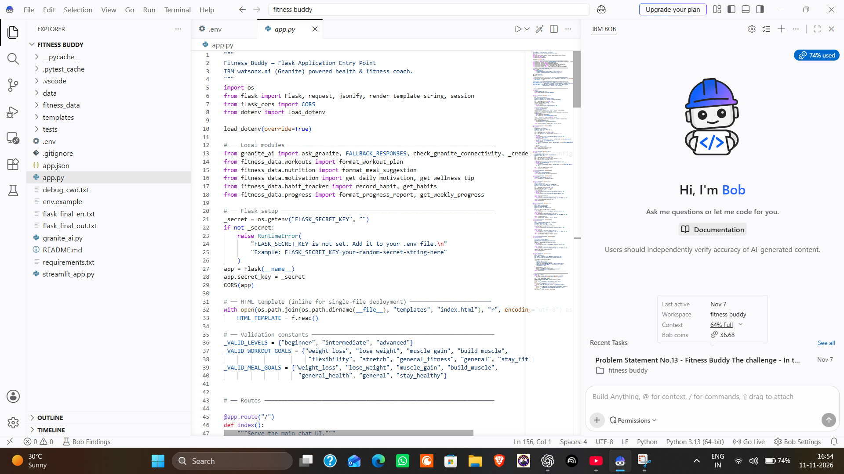
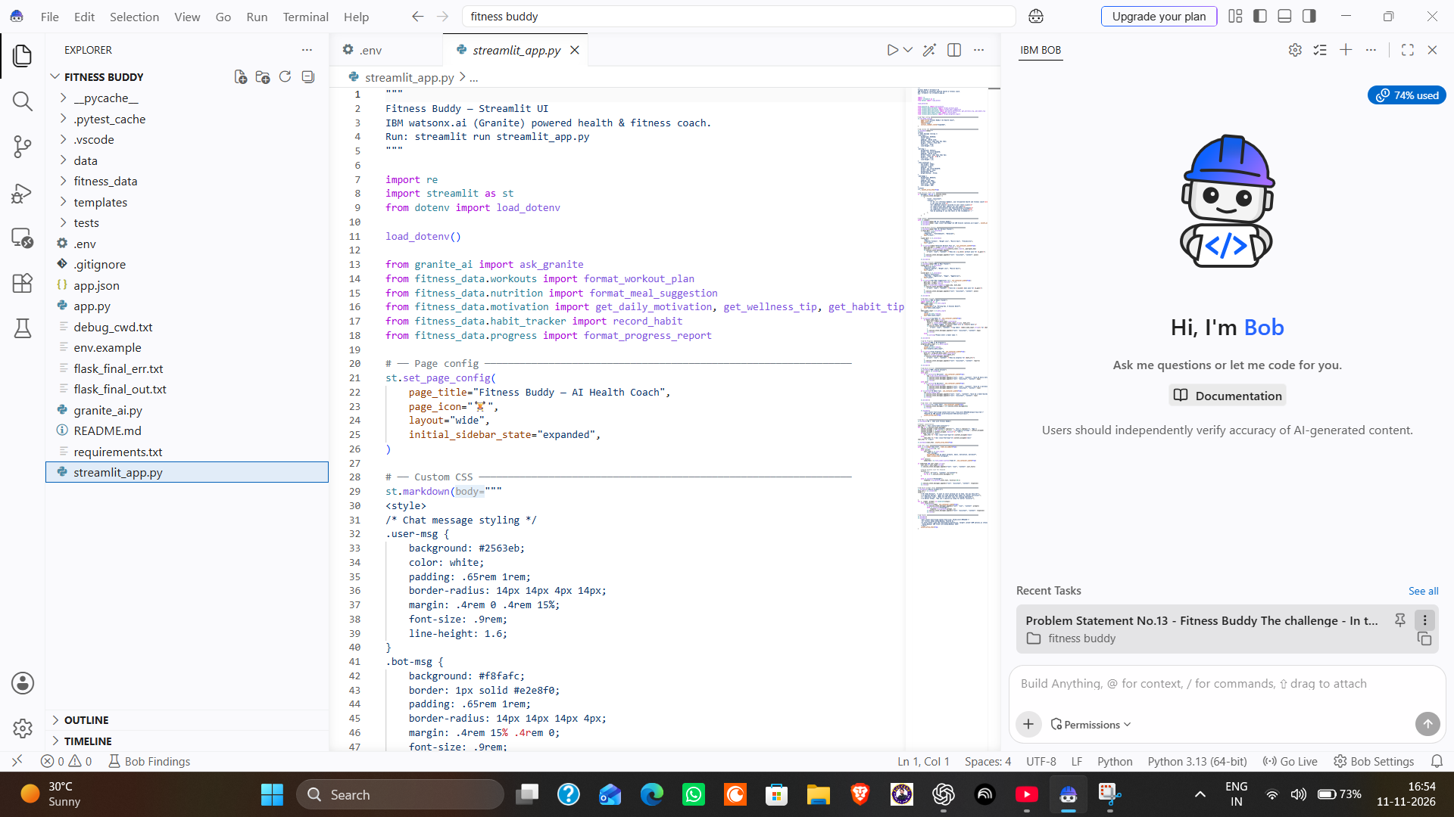
Development Process Using IBM Bob
Actual project files open in the IBM Bob IDE during implementation.
Backend implementation — app.py
Frontend implementation — streamlit_app.py
Flask routes, request handling, validation and the integration points used by the Fitness Buddy application.
Streamlit page setup, interface layout, chat styling and connections to the workout, nutrition, habit and progress modules.

Slide 8
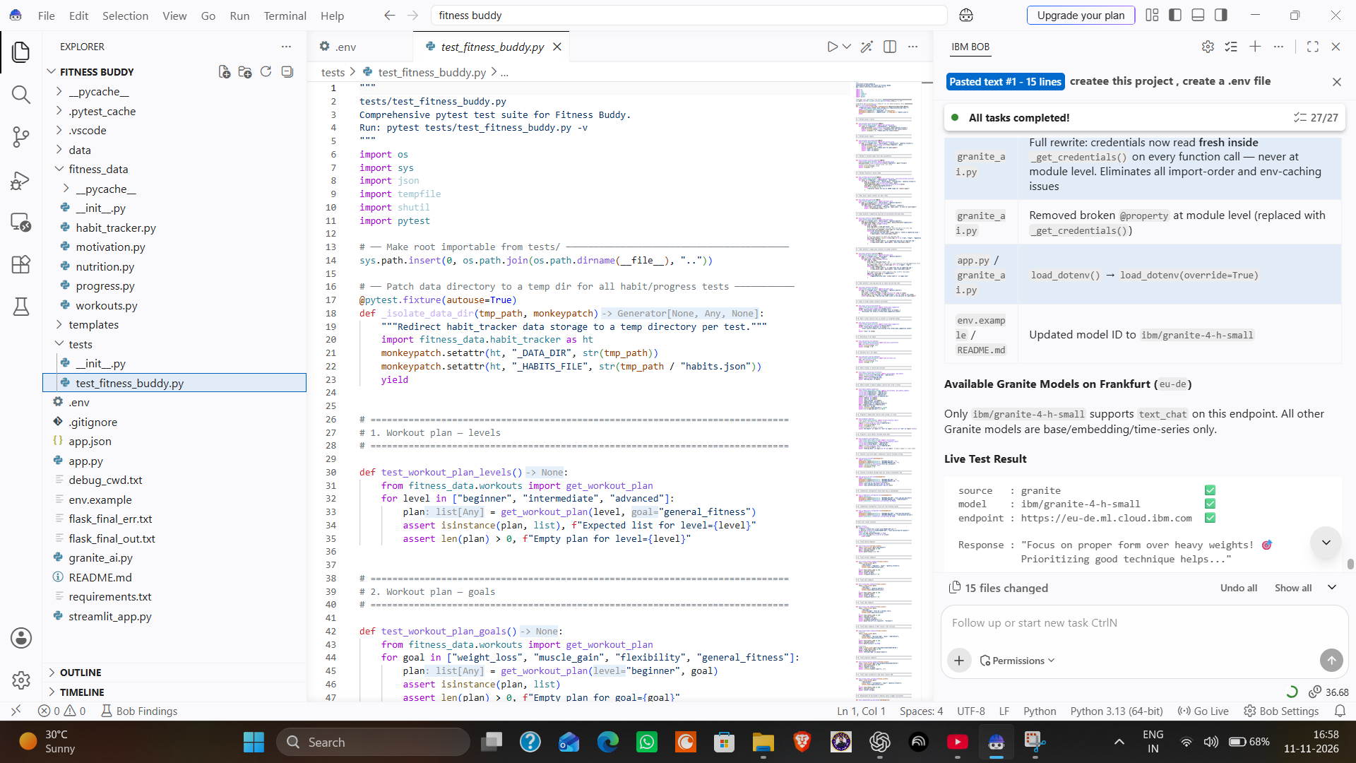
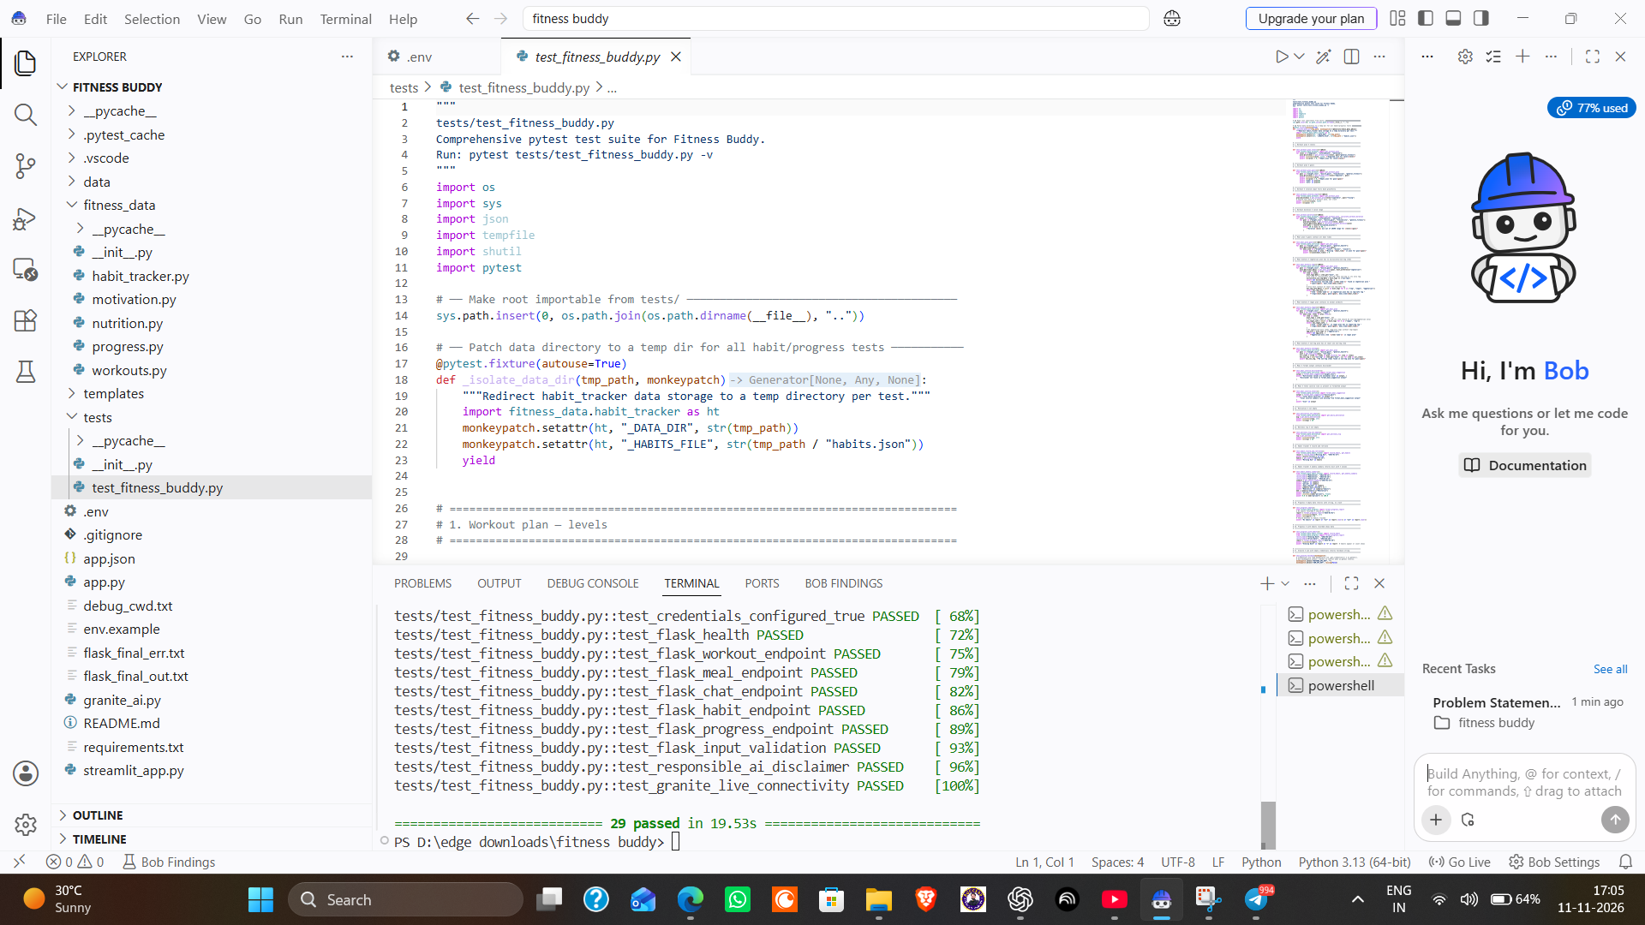
IBM Bob Implementation & Verification
Development-task completion, live IBM Granite inference and automated test evidence.
IBM Bob task completion & Granite live test
Automated testing with pytest
Bob reports 27/27 development tasks completed. The live test panel shows source: granite, model ibm/granite-4-h-small and the Frankfurt endpoint.
The local test run collected 29 tests and finished with 29 passed in 19.53 seconds.

Slide 9
Agent Workflow
REQUEST-TO-RESPONSE FLOW
1. USER INPUT
2. INTENT ROUTER
3. SPECIALIST MODULE
4. IBM GRANITE
5. COACH RESPONSE
Question + selected profile
Choose relevant task type
Build task-specific prompt
watsonx.ai Runtime inference
Actionable answer + safety note
HABIT & PROGRESS LOOP
User records a habit
Local JSON log
7-day progress view
Daily checklist selection
data/habits.json
Completion summary for reflection
The prototype uses bounded task routing and user-triggered actions. It does not run autonomous background agents or retrain the model from user history.

Slide 10
Architecture Blueprint
PRESENTATION LAYER
ORCHESTRATION LAYER
IBM CLOUD LAYER
RESPONSE & GUARDRAILS
Streamlit browser UI
Flask REST API (alternative)
Profile context
Intent classification
Specialist prompt builder
watsonx.ai Runtime
IBM Granite 4 H Small
Inference API
Readable coach response
Safety reminders
Practical next steps
LOCAL DATA LAYER
SECURE CONFIGURATION
PROJECT BOUNDARY
data/habits.json
Daily habit records and weekly summary.
Stored locally in the MVP.
WATSONX_API_KEY • PROJECT_ID • URL • MODEL_ID
Loaded from .env / secrets.
Never committed to GitHub.
Text-based prototype • sample meal guidance
No wearable, voice or medical-record integration yet.
Primary runtime path: Streamlit → task routing → IBM watsonx.ai Runtime → IBM Granite → formatted response. Flask provides an alternative API entry point.

Slide 11
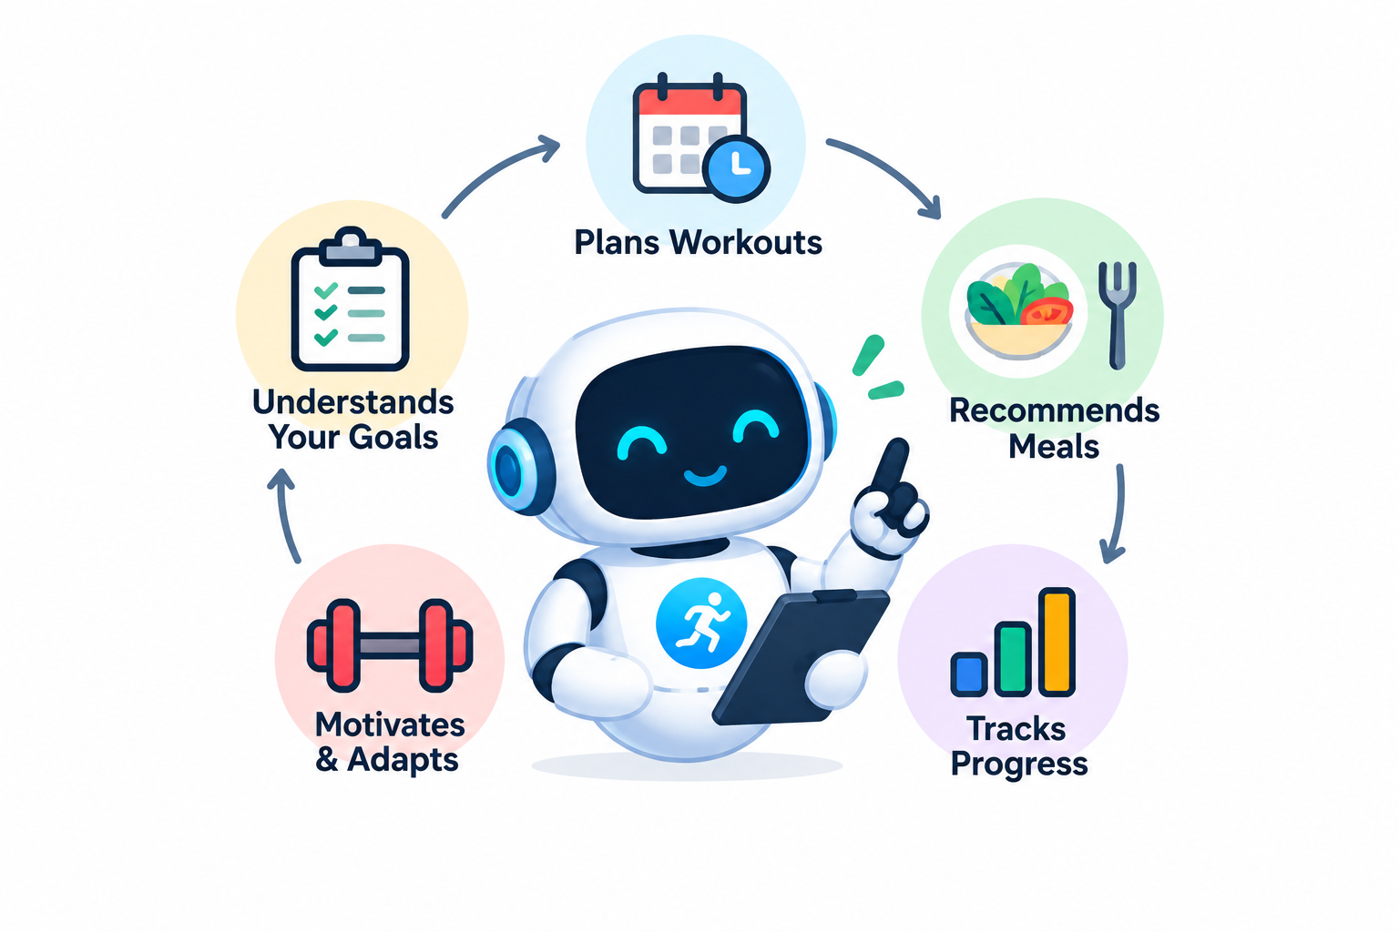
Role of Agentic AI in Fitness Buddy
INTENT-AWARE ACTION
Recognizes the request type and routes it to a workout, nutrition, motivation/habit or general fitness prompt.
PERSONALIZATION
Uses the user-stated goal, fitness level, available minutes, equipment and food preference as prompt context.
SPECIALIST TASK HANDLING
Each task module shapes the instruction for IBM Granite instead of using one generic prompt for every request.
CONTINUITY THROUGH HABITS
Local habit records and a 7-day summary help users reflect on consistency and choose a next step.
CONTROLLED, USER-LED SUPPORT
The user decides what to follow; the prototype does not autonomously prescribe or execute health actions.
Understand → Plan → Respond → Track

Slide 12
Responsible AI & Prototype Boundaries
NO MEDICAL DIAGNOSIS
SAFE FITNESS GUIDANCE
Fitness Buddy is an educational assistant. It does not diagnose conditions, treat illness or replace qualified professionals.
Avoids extreme routines and encourages users to stop if they experience serious symptoms such as chest pain, faintness or severe breathlessness.
NUTRITIONAL CAUTION
PRIVACY & USER CONTROL
Meal suggestions are general ideas. Calorie and macro values are estimates, not medical diet prescriptions.
Profile details are user-provided. Habit data is stored locally for this prototype; credentials are kept outside the public repository.
If serious symptoms occur: stop exercising and seek appropriate medical help. Users should consult a qualified professional for medical conditions, injuries or special dietary needs.

Slide 13
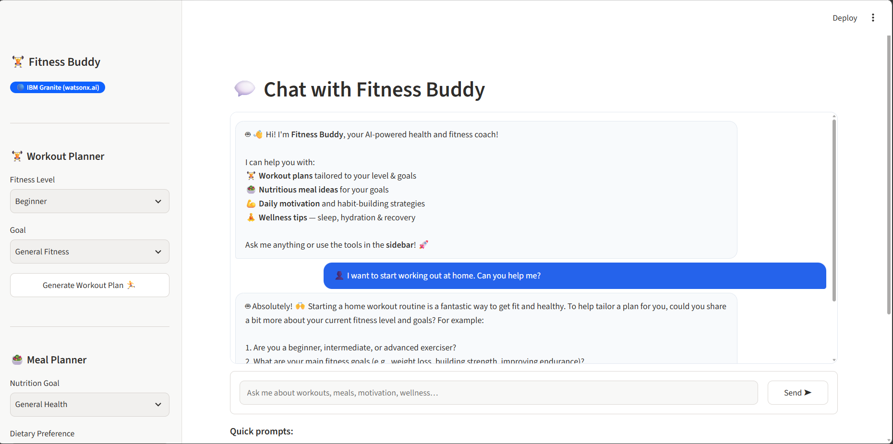
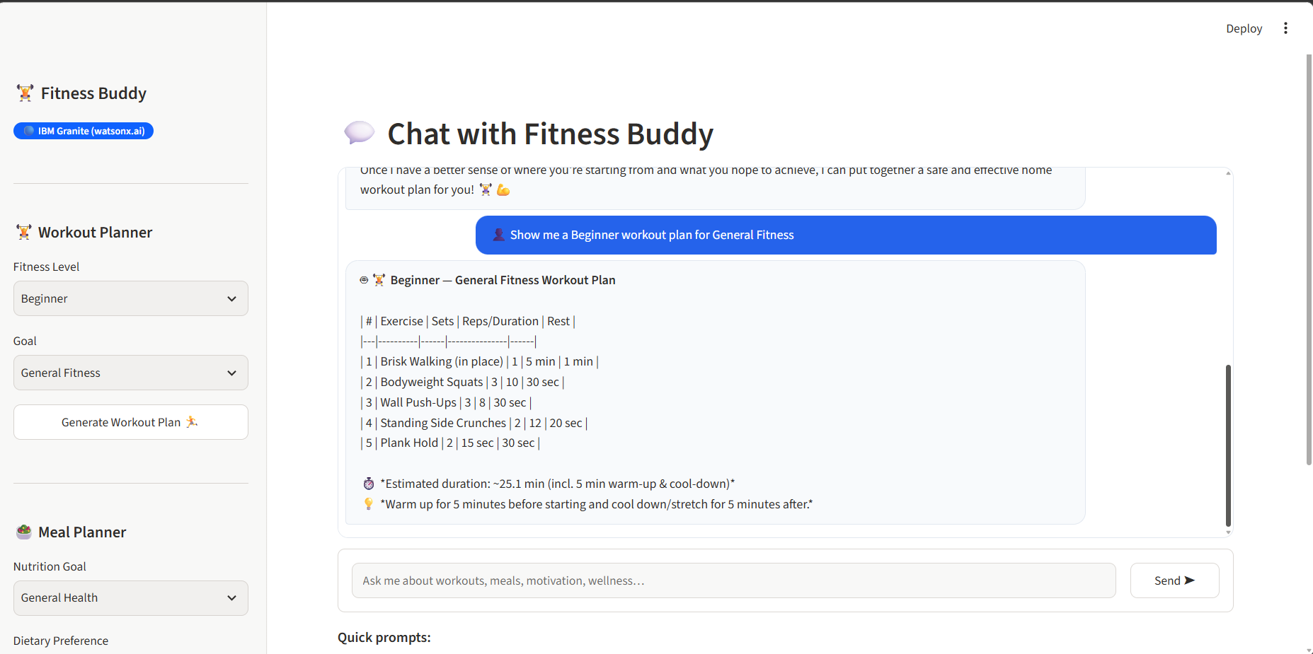
Demo / Simulation — Actual Application Screens
The screenshots below are from the running local Streamlit prototype.
1. Chat interface and feature navigation
2. Beginner workout plan generated in the UI
DEMO INPUT
USER INTERACTION
VISIBLE OUTPUT
Beginner • General Fitness • No equipment
Ask a natural-language question or use the sidebar planner.
The app displays a structured routine and coaching guidance.

Slide 14
Prototype Testing & Results
29 / 29
LIVE IBM GRANITE INFERENCE VERIFIED
Model: ibm/granite-4-h-small | Endpoint: Frankfurt (eu-de) | API source: granite
Automated tests passed
TEST COVERAGE REPORTED BY THE PROJECT AUDIT
Workout plans
Meal planner
Habits & progress
Levels, goals, duration bounds
Diet filters and calorie summary
Record, retrieve and 7-day summary
API & validation
Safety
Granite connector
Endpoints, invalid input handling
Medical disclaimer and credential guards
Fallback separation and live inference check
Test figures reflect the IBM Bob audit report and local project run. Re-run the test suite after any further code change.

Slide 15
Novelty and Uniqueness
Fitness Buddy combines conversational coaching with small, practical tools that help users move from a question to a realistic next step.
Requests are directed to specialist workout, nutrition, motivation/habit or general fitness instructions.
01 TASK-SPECIFIC ROUTING
Recommendations reflect the user's selected goal, skill level, time, equipment and food preference.
02 CONSTRAINT-AWARE ADVICE
03 EVERYDAY USABILITY
A simple Streamlit interface brings chat and common planning actions into one browser view.
04 CONSISTENCY SUPPORT
A local habit checklist and 7-day summary emphasize repeatable habits instead of perfection.
05 RESPONSIBLE SCOPE
The prototype is explicit about its educational role and avoids diagnosis or extreme recommendations.
Differentiator: a lightweight, student-built prototype focused on approachable personalization and habit continuity.

Slide 16
GitHub Repository & Submission
PUBLIC GITHUB REPOSITORY
https://github.com/keshavpareek603-star/fitness-buddy-agent
REPOSITORY CONTENT
PUBLISHING & SECURITY
• Python application source
• fitness_data, templates and tests
• app.json, README.md and requirements.txt
• env.example and .gitignore
• Problem_statement_Fitness_Buddy.pdf
• Repository visibility: Public
• .env and API secrets are excluded
• Personal habit data is excluded
• Final PPTX must be added to this repository after completion
• Use the same final PPTX in the official submission portal

Slide 17
Future Scope
Voice and multilingual access
Add speech input/output and support regional languages to improve accessibility.
Wearable integration
With user consent, use selected activity or sleep summaries from compatible devices.
Reviewed wellness knowledge
Add a curated knowledge base with reliable sources, dates and citations for general wellness information.
Richer habit insights
Offer opt-in reminders, streaks, weekly reflections and user-controlled export.
Secure cloud deployment
Consider authenticated cloud storage only after consent, retention and data-deletion controls are designed.

Slide 18
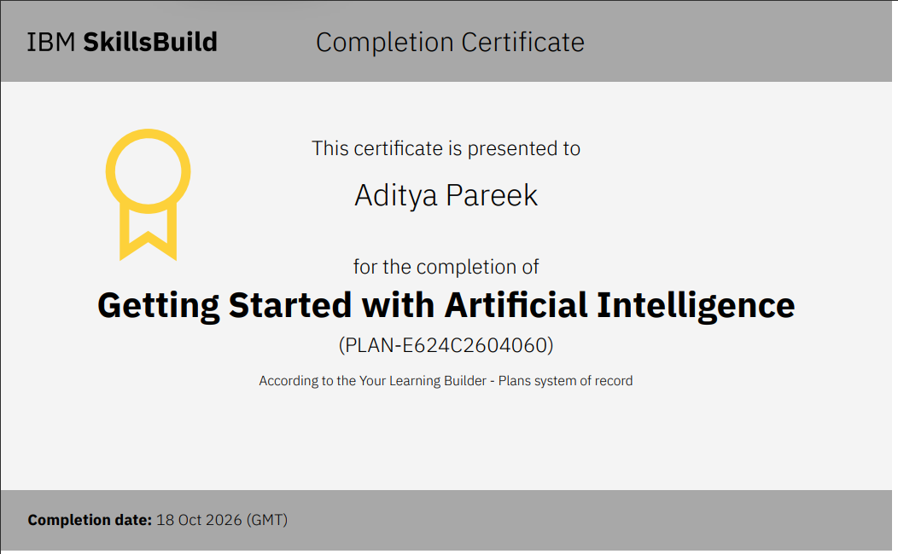
Certificates Earned — IBM SkillsBuild
(Getting Started with Artificial Intelligence)
16

Slide 19
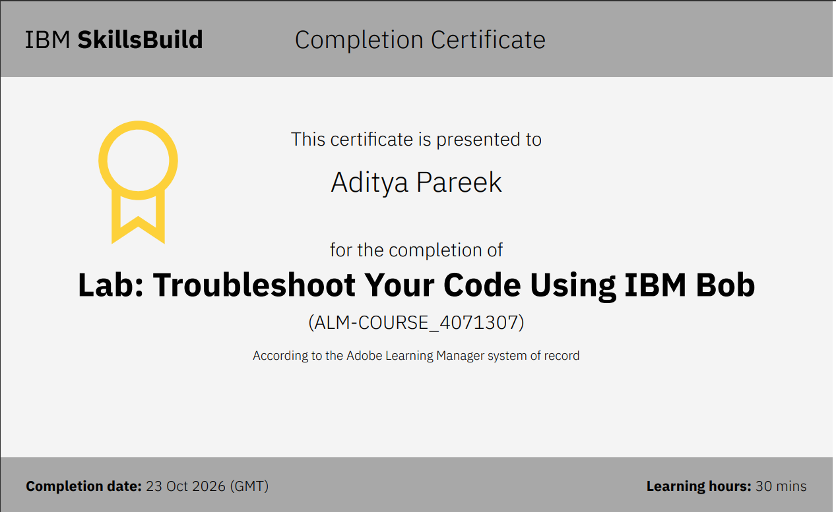
Certificate Earned — IBM Bob
(Lab: Troubleshoot Your Code Using IBM Bob)

Slide 20
Thank You!
Fitness Buddy — AI-Powered Fitness Coach
Questions & feedback are welcome.

